Slide 1
Principles, Preparation & Problems
Unlocking God’s Word
How to Study the Bible

Slide 2
Principles of Bible Study

Slide 3

1. Ask the right kinds of QUESTIONS
Principles of Bible Study

Slide 4
I keep six honest serving-men
(They taught me all I knew);
Their names are What and Why and When
And How and Where and Who.
The Elephant’s Child
Rudyard Kipling

Slide 5

2. Write down your OBSERVATIONS and DISCOVERIES
Principles of Bible Study

Slide 6
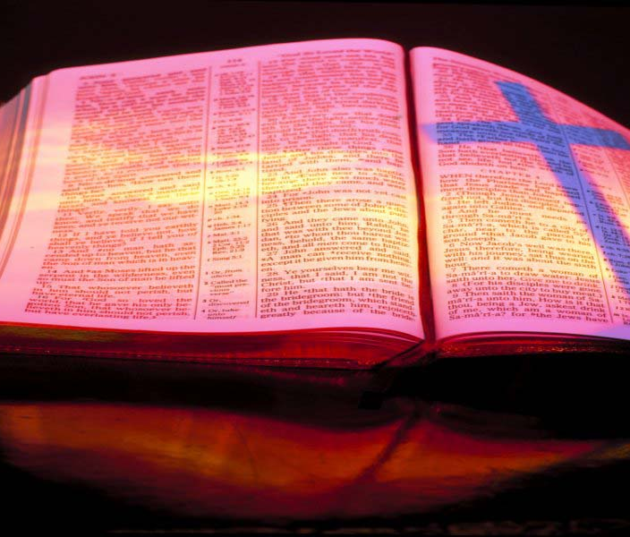
3. The goal of Bible Study is APPLICATION
Principles of Bible Study

Slide 7

4. Bible Study must be SYSTEMATIC
Principles of Bible Study

Slide 8
Preparing For Bible Study

Slide 9

1. SCHEDULE your Bible Study
Preparing for Bible Study

Slide 10

2. Keep a JOURNAL
Preparing for Bible Study

Slide 11
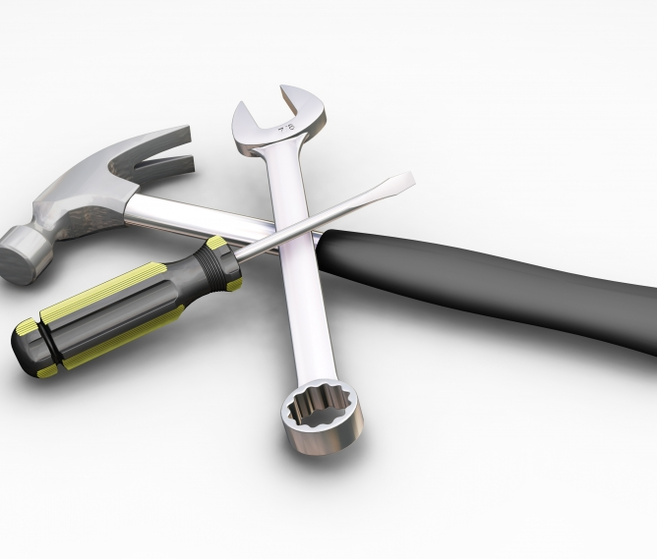
3. Get the right TOOLS
Preparing for Bible Study

Slide 12

4. PRAY before each study
Preparing for Bible Study

Slide 13
Problems facing Bible Study

Slide 14
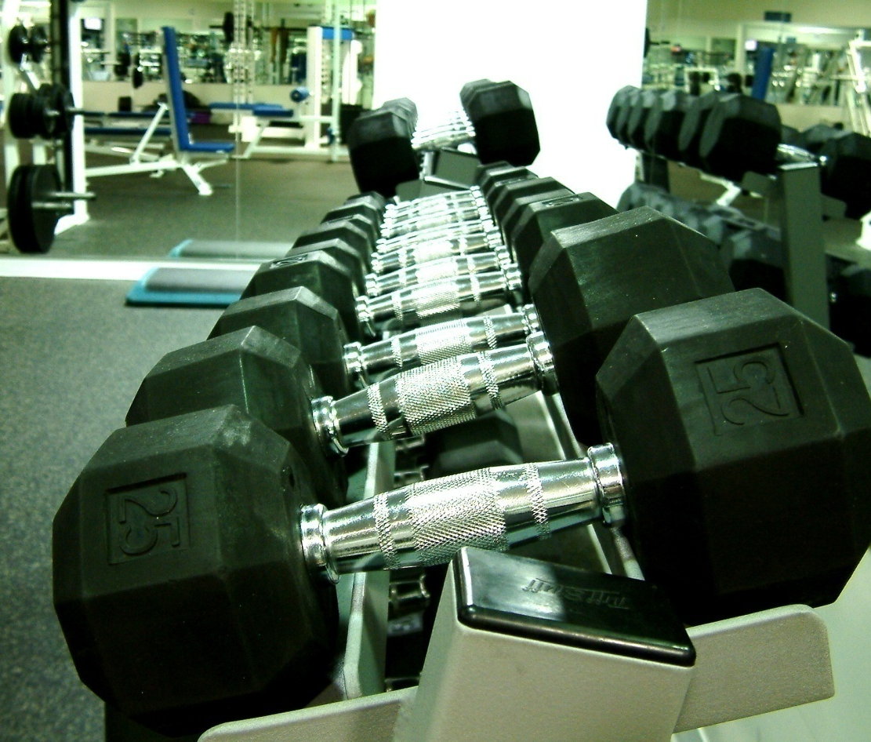
1. The Problem of DISCIPLINE
Problems facing Bible Study

Slide 15
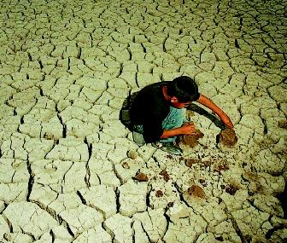
2. The Problem of DRY SPELLS
Problems facing Bible Study

Slide 16
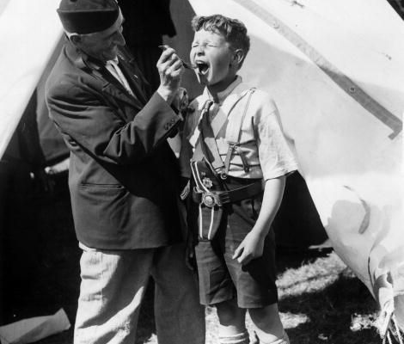
The Castor Oil Stage
We study the Bible because we know it is good for us, but it is not too enjoyable.

Slide 17

The Cereal Stage
Our Bible Study is dry and uninteresting, but we know it is nourishing.

Slide 18
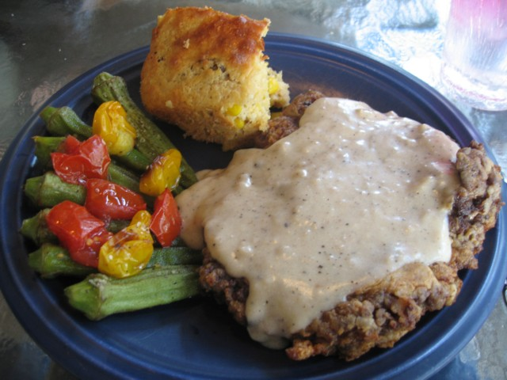
The Country Fried Steak Dinner Stage
  We are now really feasting on the word of God.

Slide 19

Disobedience
Other causes of long periods of dryness

Slide 20

Physical Condition
Other causes of long periods of dryness

Slide 21

Trying to do too much
Other causes of long periods of dryness

Slide 22

Being in a rut
Other causes of long periods of dryness

Slide 23
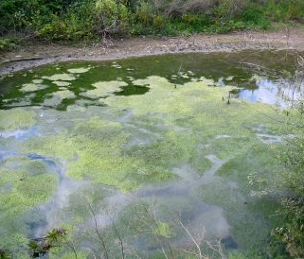
Not sharing your insights with others
Other causes of long periods of dryness

Slide 24

3. The Problem of DISTRACTIONS
Problems facing Bible Study

Slide 25
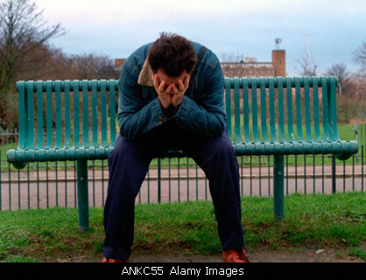
4. The Problem of DISCOURAGEMENT
Problems facing Bible Study

Slide 26
Principles, Preparation & Problems
Unlocking God’s Word
How to Study the Bible

