Slide 1
The Devotional Method
Unlocking God’s Word
How to Study the Bible

Slide 2
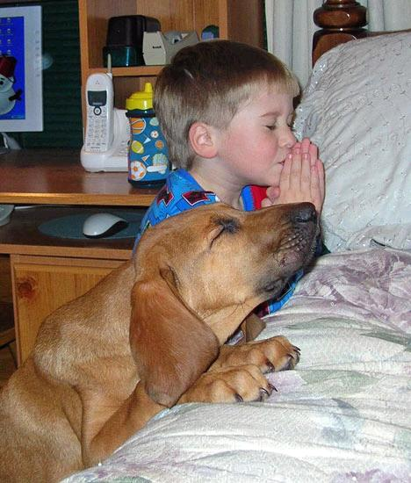
Pray
Ask God to help you apply the scripture and to show you specifically what he wants you to do

Slide 3
Read
Read the passage aloud, but quietly several times.

Slide 4
Luke 12:22-26
Then Jesus said to his disciples: "Therefore I tell you, do not worry about your life, what you will eat; or about your body, what you will wear. Life is more than food, and the body more than clothes. Consider the ravens: They do not sow or reap, they have no storeroom or barn; yet God feeds them. And how much more valuable you are than birds! Who of you by worrying can add a single hour to his life? Since you cannot do this very little thing, why do you worry about the rest?

Slide 5
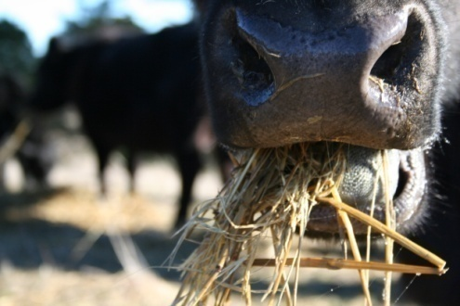
Meditation
Meditation is the key to discovering how to apply Scripture to your life.

Slide 6
Meditation Techniques
Imagine the scene of the story
Emphasize different words in the passage

Slide 7
Philippians 4:13
I can do everything through him who gives me strength.
I can do everything through him who gives me strength.
I can do everything through him who gives me strength.
I can do everything through him who gives me strength.
I can do everything through him who gives me strength.
I can do everything through him who gives me strength.
I can do everything through him who gives me strength.
I can do everything through him who gives me strength.
I can do everything through him who gives me strength.
I can do everything through him who gives me strength.

Slide 8
Meditation Techniques
Imagine the scene of the story
Emphasize different words in the passage
Paraphrase the passage
Personalize the passage
PACE your STEPS acronym
Pray the verse back to God

Slide 9
Meditation
Which technique(s) can we use on Luke 12:22-26?

Slide 10
Meditate
My personalized paraphrase
I shouldn’t worry so much. God will take care of all my needs. Since God game me my life, surely I can trust him to sustain it. I can learn from the example of the birds: they don’t worry about the future. God takes care of them on a daily basis. And if God takes care of the birds, of course he will take care of me! Besides, worrying never does me any good. It never changes the situation. So what’s the use of worrying? NONE!!
Command to obey: Don’t Worry (v. 22)
Promise to claim: God will take care of me (v. 24)

Slide 11
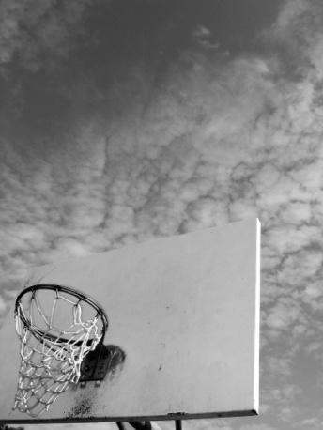
Application
The GOAL of Bible Study is to transform my character to be like Christ’s, therefore, I must apply the passage.

Slide 12
Application is Necessary
You can’t really get to KNOW the Word of God
Merely studying the Word of God can be DANGEROUS
Knowledge puffs up
Knowledge requires action
Knowledge increases RESPONSIBILITY

Slide 13
Application is hard work
It requires SERIOUS THINKING
Satan FIGHTS it viciously
We naturally resist CHANGE

Slide 14
Characteristics of an Application
My application should be PERSONAL
My application should be PRACTICAL
My application should be POSSIBLE
My application should be PROVABLE

Slide 15
Example
Personal: “I need to…”
Practical: “I need to exercise.”
Possible: “I need to exercise 20 minutes a day.”
Provable: “I need to exercise 20 minutes a day for the next 30 days”

Slide 16
Application
What can I learn about myself and change in me from Luke 12:22-26 to become more like Jesus?

Slide 17
Application
I need to apply this lesson in the area of my debt. My debt is an expression of my mistrust of God. I have purchased things that God did not think I needed, or he would’ve provided them for me. In emergency situations, I relied on the ways of man (money fixes everything) to overcome those problems.
For the next month (I’ll take this one month at a time), every time the devil tempts me to rely on myself and use our credit cards, I’ll resist the thought by praying Luke 12:24 back to God, affirming that He will meet all my needs.

Slide 18
Memorization
By committing a key passage to memory I can continue to meditate on the passage that I am applying and help focus me on my project.

Slide 19
Memorization
Luke 12:24
“Consider the ravens: They do not sow or reap, they have no storeroom or barn; yet God feeds them. And how much more valuable you are than birds!”

Slide 20
The Devotional Method
Unlocking God’s Word
How to Study the Bible

