Slide 1
The Background Method Unlocking Gods Word: How to Study the Bible

Slide 2
What is this method
This method allows you to gain a better understanding of the biblical message by researching the background related to the passage, person, event or topic being studied.
This involves understanding the geography, historical events, culture, and political environment at the time a particular part of the Bible was written.
Notes:
Sample Verse Layout Type 1

Slide 3
Why this method?
Context matters
Customs differ
Notes:
Sample Verse Layout Type 1

Slide 4
Tools
Bible dictionary/encyclopedia
Bible Handbook
Bible Atlas
Internet
Many of these are available at the public Library.
Notes:
Sample Verse Layout Type 1

Slide 5
--------------------------
Prayer
Ephesus: Book of Ephesians
Notes:
Blank

Slide 6
Choose the subject
Notes:
Sample Point Layout Type 2

Slide 7
Reference Tools
Allows follow up
Helpful for next study
Notes:
Sample Point Layout Type 2

Slide 8
--------------------------
Reference Tools
Hailey’s Bible Handbook
Smith’s Bible Dictionary
Wikipedia
Study Bible Book Introduction
Ephesus: Book of Ephesians
Notes:
Blank

Slide 9
Insights from Geography
Need to be familiar with the geography of the Israel and the Near/Middle East.
Things like knowing:
Types of land found there
Major mountains and hills
Major bodies of water (seas, lakes, rivers)
Locations of cities and countries
What is the effect of the surrounding geography on the subject or book I am studying?
Notes:
Sample Point Layout Type 2

Slide 10
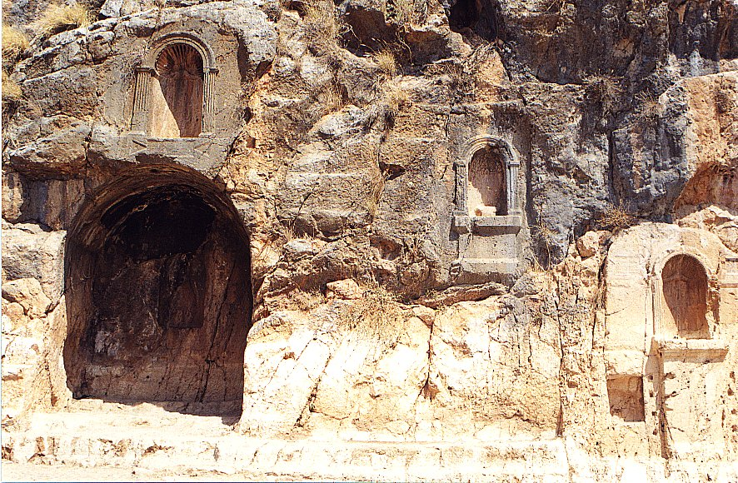
Gates of Hades

Slide 11
--------------------------
Geography
The city of Ephesus was located on the western coast of Asia Minor a the mouth of the Cayster River, one of the four major east-west valleys that ended in the Aegean sea. It was also the beginning of a major highway that stretched eastward across Asia Minor into Syria, Mesopotamia, Persia and India.
Ephesus was a large port city and had a population around 400,000 during Roman occupation. It was considered the most important city in the Roman province of Asia because it was at its location that land and sea trade routes converged.
Ephesus: Book of Ephesians
Notes:
Blank

Slide 12
Insights from History
A working knowledge of the chronology (order of historical events) of the nation of Israel in the OT
Understand the major events going on in other parts of the world
What caused this particular event that I am studying?
How did affect the people involved?
How did it affect the passage I am studying?
Notes:
Sample Point Layout Type 2

Slide 13
--------------------------
History
Archaeologyy shows that the area around Ephesus was populated as early as 6000 BC. The first definitive origin shows that Ephesus was an important port city in the days of the ancient Hittites (early 1300 BC).
Around 1080 BC it was taken and colonized by the Greeks, introducing Greek ways and philosophies. Five centauries later it was restored to its Asian (mid-East) influences when it was taken by King Croesus.
The Persians conquered Ephesus in 557 BC and used it as a staging area for their conflicts with the Greeks that lasted for 200 years, ending when Alexander the Great captured the city in 335 B.C.
The Romans took the city in 190 BC where it became a major city in the Roman province of Asia (Although Pergamum remained the capital).
Ephesus: Book of Ephesians
Notes:
Blank

Slide 14
Insights from Culture
How do these things affect the message the people about whom I am studying?
Types of clothes worn
Professions and trades in Biblical Time
Music in the Bible
Architectural styles in the Near East
Manners and customs in scripture
Recreation in ancient times
Family life in the Middle East
Art in the Bible
Languages and literature of surrounding nations
Religious ceremonies in Israel and among pagan neighbors
False religions of the area
Weapons and tools used by the people
Notes:
Sample Point Layout Type 2

Slide 15
--------------------------
Culture
From the time the Greeks took the city in 1080 BC, cultural conflicts existed between Asian and Greek ways of life. The original religion included the worship of a mother-goddess whom the Greeks later called Artemis (Diana in the Roman system). Here the original goddess had a shrine and the Greeks later built a grand temple.
Being at the crossroads of Europe and the East, the city has an international flavor as people of many backgrounds, particularly tradesman and sailors, mixed here freely.
Thus, it was a cosmopolitan city, primarily Greek in culture yt wih Asian underpinnings.
Ephesus: Book of Ephesians
Notes:
Blank

Slide 16
Insights from Politics
Who are the rulers (kings, emperors, rulers, other governors)?
What was the political “hot topic” of the day?
Notes:
Sample Point Layout Type 2

Slide 17
--------------------------
Politics
In Paul’s day, since it was a city loyal to Rome, it was governed by the Roman proconsul from Pergamum. It was allowed to have its own government and was divided into “tribes” according to the ethnic compositions of its population.
Ephesus: Book of Ephesians
Notes:
Blank

Slide 18
Summary of Insights
How does this background information help me understand better what I am studying?
What influence did any of these factors have on the book I am studying?
Notes:
Sample Point Layout Type 2

Slide 19
--------------------------
Summary
The city of Ephesus was an important city because of its strategic value. Paul and his team headed there on their second missionary journey. Paul later ministered there for 3 years during his third journey (Acts 19). After Paul left, Timothy stayed behind to continue the work (I Timothy 1).
Because of its cosmopolitan population, here was an opportunity for ministry to many different kinds of peoples – Romans, Greeks, and the Asians. Also, a ministry could be had with the travelers and traders who cam and went by both land and sea.
Ephesus’ history and geography made the city a strategic place for the planting of churches and spreading the good news throughout the whole territory.
Ephesus: Book of Ephesians
Notes:
Blank

Slide 20
--------------------------
Application
It is my responsibility to witness to
Ephesus: Book of Ephesians
Notes:
Blank

