Slide 1
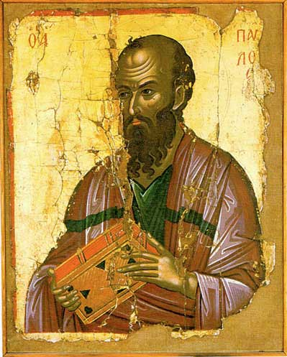
The Apostle Paul
A Journey in Discipleship
“And you should imitate me, just as I imitate Christ.”
Apostle Paul (Paulus of Tarsus) Stavronikita Monastery , Athos Theophanes Kris

Slide 2
Background
A Roman Citizen
A Hebrew of Hebrews
A Pharisee the son of a Pharisee
A Student of Gamaliel
St Paul, by El Greco

Slide 3
How to become a Rabbi
Beth Sefer
Elementary School (Ages 5-10)
Memorize the Torah
Beth Midrash
Secondary School (Ages 11-14)
Study the Prophets and Writings
Talmidim
Study with a famous Rabbi to learn their “yoke”
Goal: For the student to become what the teacher is
Study the interpretations of the Torah

Slide 4
Paul Persecutes the Church
Paul was a disciple of Gamaliel
What do we know about Gamaliel?
(Acts 5:34-39)
What was Saul doing?
(Acts 8:1, 9:1,2)
Saul was FAILING as a talmidim
The Martyrs Mirror
Jan Luiken
1660

Slide 5
Paul's Repentance
There was NO Damascus Road conversion
By making this Paul’s conversion, we say that the Jewish system wasn’t working.
What happens if we redefine this episode as repentance?
Is he persecuting the church as an unbeliever or as a believer who is misled?
Does this idea change how we approach people in AL (the buckle of the Bible Belt)?
The conversion on the way to Damascus
Caravaggio

Slide 6
Paul's Planting
Missionary Journey 1 & 2
TOTAL 15 churches in 3½ years
Average: 5 churches per year
Every one of them has problems
The next 8 years will be spent
either travelling or in just two
churches
What changed?
Saint Paul
Byzantine ivory relief

Slide 7
Paul & Timothy
Timothy’s mother was Jewish and his father was Greek
Timothy most likely wanted to be a Rabbi
Timothy’s bi-racial ethnicity prevented him from becoming talmid
Timothy was a top student (Acts 16:2).
Paul takes Timothy on as his talmid
Paul and Timothy in the Barberini Latin Code 587, Vatican Apostolic Library

Slide 8
Paul in Ephesus
Paul meets a group of John the Baptist’s disciples
He baptizes the 12 men and takes them on his disciples (talmid)
Teaches for 3 years
The Ephesian riot
Saint Paul Writing His Epistles
16th century

Slide 9
Do you know another Rabbi…
who picked disciples who had been with John the Baptist?
who chose 12 of them and taught them for 3 years?
who had a young disciple he calls “my son?”
who was falsely accused of blaspheming a temple?
who was judged innocent by a Roman official?
who was executed by the Romans?
St. Paul
Chora Museum, Istanbul

Slide 10
Application: Are you discipling?
Paul’s life is a call back to disciple making.
We have to reclaim discipleship.
How many disciples do you have?
How can I call myself a disciple of Jesus, if I don’t have a disciple of my own?
The Apostle Paul in Prison
Rembrandt
(c.1627)

Slide 11
The Apostle Paul
A Hebrew of Hebrews Disciplining the Greeks
“And you should imitate me, just as I imitate Christ.”
Apostle Paul (Paulus of Tarsus) Stavronikita Monastery , Athos Theophanes Kris

