Slide 1


Slide 2


Slide 3
Don’t Covet

Slide 4

The Precept
chamad – to desire
a‘vah – to want, to desire, to lust after

Slide 5
Do not desire the…
CIRCUMSTANCES of your neighbor
COMPLETENESS of your neighbor
COMMITMENTS of your neighbor
CAPACITY of your neighbor

Slide 6

The Principle
Coveting arises out of a DISSATISFACTION with God’s PROVISION for my life.

Slide 7
Revealed by…
The willingness to use force or fraud to TAKE what is owned by somebody else (i.e., GREED)
The willingness to use force or fraud to PREVENT others from acquiring property (i.e., ENVY)

Slide 8
The Person
God is JEHOVAH JIREH
God is the DEFENDER of the OPPRESSED.

Slide 9
Application
Learn to be CONTENT
Trust in the PROVISIONS of God
Do not be ARROGANT
SERVE others
Be GENEROUS and willing to SHARE
Look to own AFFAIRS
Spend time SEEKING God

Slide 10
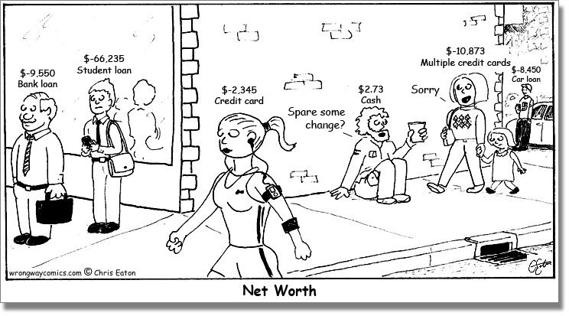
Sign of Contentment

